Slide 1
Bellringer
What are two of the constitutional compromises?

Slide 2
Lesson 1.5
Refer to Chapter 3
Introduction to the Constitution

Slide 3
What are the basic principals of the Constitution?
Popular Sovereignty
  Government power resides in the people
Limited government
  Government is not all powerful, can only do what the people let it.
Separation of Powers
  Helps prevent one branch from becoming too powerful
  Checks and Balances
Federalism
  Division of power among national and state governments

Slide 4
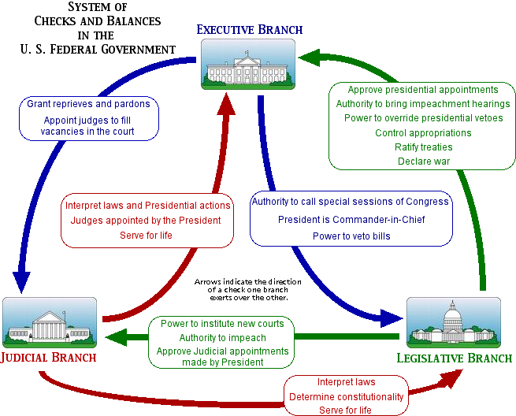
What are the Checks and Balances?

Slide 5
Federalists v. Anti-Federalists
Federalists:
  Supported the Constitution and a strong central government
  Alexander Hamilton, James Madison, John Jay
  Federalist Papers – series of articles written in defense of the Constitution
Anti-Federalists:
  Supported a weaker central government – felt too much power was taken away from the states
  Opposed the Constitution
  Wanted a Bill of Rights included
  Samuel Adams, Patrick Henry

Slide 6
Structure of the Constitution
Preamble:
  Statement of purpose
Articles:
  I: Legislative Branch
  II: Executive Branch
  III: Judicial Branch
  IV: Relations Among the States
  V: Amendment Process
  VI: Federal Power
  VII: Ratification
Amendments:
  27 Total
  1st ten are the Bill of Rights

Slide 7
Article I: Legislative Branch
Bicameral:
  Senate
    2 Senators for each state
  House of Representatives
    Based on population
Reps serve for 2 year terms
Senators serve for 6 year terms
Important Powers:
  Make laws
  Set taxes
  Declare war
  Override Vetoes
  Borrow money
  Regulate international and national trade
  Print money

Slide 8
Article II: Executive Branch
President and Vice President are elected to 4 year terms
Qualifications:
  At least 35 years old
  14 year resident of the US
  Natural born citizen
Elected by the Electoral College
Important powers:
  Commander-in-Chief
  Grant pardons
  Make treaties
  Appoint federal officers
  Ensure laws are executed

Slide 9
Article III: Judicial Branch
Supreme Court judges serve for life unless impeached.
Judicial power rests with US Supreme Court and other courts created by Congress
Important Powers:
  Decides cases of Constitutional law and federal law
  Cases involving ambassadors go straight to Supreme Court
  Judicial Review comes later (1803 – Marbury v. Madison)

Slide 10
Important Amendments:
Bill of Rights
Freedom of religion, of speech, of the press, to assemble, and to petition
Right to bear arms
No quartering of soldiers
No unreasonable search and seizure
Indictments; Due process; Self-incrimination; Double jeopardy, and rules for Eminent Domain.
Right to a fair and speedy public trial, Notice of accusations, Confronting one's accuser, Subpoenas, Right to counsel
Right to trial by jury in civil cases
No excessive bail & fines or cruel & unusual punishment
There are other rights not written in the Constitution
All rights not given to Federal Government belong to states and people.

Slide 11
Other Important Amendments:
Reconstruction Amendments
13th Amendment
  abolished slavery
14th Amendment
  Due process and equal protection under the law
  All persons born in US are citizens
15th Amendment
  Right to vote regardless of race, color, or previous servitude

Slide 12
Other Important Amendments:
18th Amendment
  Prohibition of alcohol
19th Amendment:
  Women’s suffrage
21st Amendment:
  Repeals prohibition
22nd Amendment:
  Presidential term limits
24th Amendment:
  Prohibits poll taxes for voting
26th Amendment:
  lowers voting age to 18

