Slide 1
Bellringer
How many articles are in the Constitution? How many amendments are there to the Constitution?

Slide 2
Lesson 1.6
Refer to Chapter 4
Federalism

Slide 3
Federalism and Types of powers
Federalism is a system in which the written constitution divides the power of government on a territorial basis, between the national, state and local government.
The expressed powers are those found directly within the Constitution.
Collect taxes
Coin money
Regulate foreign and interstate commerce
The implied powers are not expressly stated in the Constitution, but are reasonably suggested, or implied by, the expressed powers. (Elastic Clause)
The inherent powers belong to the National Government because it is the government of a sovereign state within the world community.
regulate immigration.

Slide 4
Exclusive, Concurrent, and Reserved Powers
Exclusive Powers
Powers that can be exercised by the National Government alone are known as the exclusive powers.
National Government’s power to coin money, to make treaties with foreign states, and to lay duties (taxes) on imports.
Concurrent Powers
The concurrent powers are those powers that both the National Government and the States possess and exercise.
The power to levy and collect taxes, to define crimes and set punishments for them, and to claim private
Reserved Powers
The reserved powers are those powers that the Constitution does not grant to the National Government and does not, at the same time, deny to the States.

Slide 5
Powers Denied to the National Government
Powers are denied to the National Government in three distinct ways:
Some powers, such as the power to levy duties on exports or prohibit the freedom of religion, speech, press, or assembly, are expressly denied to the National Government in the Constitution.
Also, some powers are denied to the National Government because the Constitution is silent on the issue.
Finally, some powers are denied to the National Government because the federal system does not intend the National Government to carry out those functions.

Slide 6
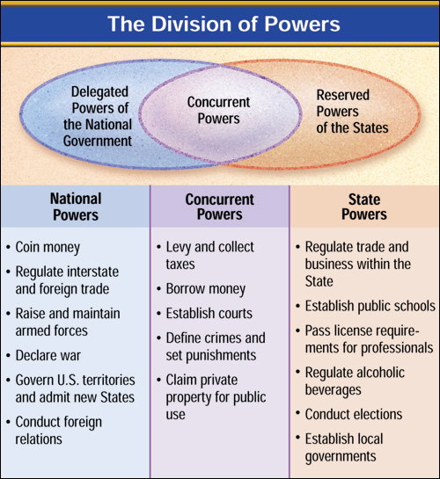
Powers Denied to the States
Just as the Constitution denies many powers the National Government, it also denies many powers to the States.
Powers denied to the States are denied in much the same way that powers are denied to the National Government; both expressly and inherently.

Slide 7
The Nation’s Obligations to the States
Republican Form of Government
The Constitution requires the National Government to “guarantee to every State in this Union a Republican Form of Government.”
Invasion and Internal Disorder
The National Government is also required to provide defense of the States from foreign invasion, and aid in protecting against “domestic Violence” in the States.
Respect for Territorial Integrity
The National Government is constitutionally bound to respect the territorial integrity of each of the States.

Slide 8
The Supremacy Clause
The Supremacy Clause in the Constitution establishes the Constitution and United States laws as the “supreme Law of the Land.”

Slide 9
Admitting new states to the Union
Requirements:
Population of 60,000
Steps to be Admitted
State petitions Congress for admission
Congress agrees to framing of proposed Constitution
Convention prepares Constitution; popular statewide vote
Voters approve; Constitution submitted to Congress
Congress agrees to statehood and Constitution; passes act of admission
President signs act, new state enters the Union

Slide 10
Cooperative Federalism
Even though the basis of federalism is the division of powers between levels of government, there is still much cooperation between them.
Grants-in-aid programs are grants of federal money or other resources to the States and/or their cities, counties, and other local units.
Revenue sharing, used between 1972 and 1987, gave an annual share of federal tax revenues to the States and their local governments.

Slide 11
Types of Federal Grants
Block grants are portions of money allocated to States to use for broader purposes, such as health care, social services, or welfare. Block grants often are granted with fewer strings attached.
Categorical grants are made for some specific, closely defined purpose, such as school lunch programs or the construction of airports or water treatment plants. There are usually conditions, or “strings,” attached to regulate the use of these funds.
Project grants are provided to States, localities, and sometimes private agencies that apply for them. They are used for a variety of purposes ranging from medical research to job training and employment programs.

Slide 12
Extradition, Privileges and Immunities, and Full Faith and Credit Clauses
Extradition is the legal process by which a fugitive from justice in one State is returned to that State.
The Privileges and Immunities Clause provides that no State can draw unreasonable distinctions between its own residents and those persons who happen to live in other States.
The Full Faith and Credit Clause of the Constitution ensures that States recognize the laws and, documents, and court proceedings of the other States.
There are two exceptions to the clause though:
(1) One State cannot enforce another State’s criminal laws. And,
(2) Full faith and credit need not be given to certain divorces granted by one State to residents of another State.

