Slide 1
Bell ringer
What are the Formal qualifications for the House and the Senate?
Hint: you will need 3 qualifications for each.

Slide 2
Lesson 3.3
Refer to Chapter 11
Powers of Congress

Slide 3
Objectives (Do Not Copy)
Identify the three types of Congressional powers.
Identify the Expressed Powers of Congress.
Identify the Implied Powers of Congress.
Identify the Nonlegislative Powers of Congress.

Slide 4
Congressional Powers
The Constitution grants Congress a number of specific powers in three different ways.
(1) The expressed powers are granted to Congress explicitly in the Constitution.
(2) The implied powers are granted by reasonable deduction from the expressed powers.
(3) The inherent powers are granted through the Constitution’s creation of a National Government for the United States.

Slide 5
Expressed Powers
Legal tender is any kind of money that a creditor must by law accept in payment for debts.
Bankruptcy is the legal proceeding in which the bankrupt person’s assets are distributed among those to whom a debt is owed
Naturalization
Naturalization is the process by which citizens of one country become citizens of another.

Slide 6
Other Powers
Judicial Powers
Congress may create all of the federal courts below the Supreme Court and structure the federal judiciary.
Congress may also define federal crimes and set punishment for violators of federal law.
Power Over Territories and Other Areas
One way of acquiring property is through eminent domain, the inherent power to take private property for public use.
The Postal Power
Article I, Section 8, Clause 7 says that Congress has the power “[t]o establish Post Offices and post Roads.”
Constitutional Amendments
Article V gives Congress the power to propose amendments by a two-thirds vote in each house.

Slide 7
The Commerce Power
The commerce power—the power of Congress to regulate interstate and foreign trade—is granted in the Commerce Clause of the Constitution.

Slide 8
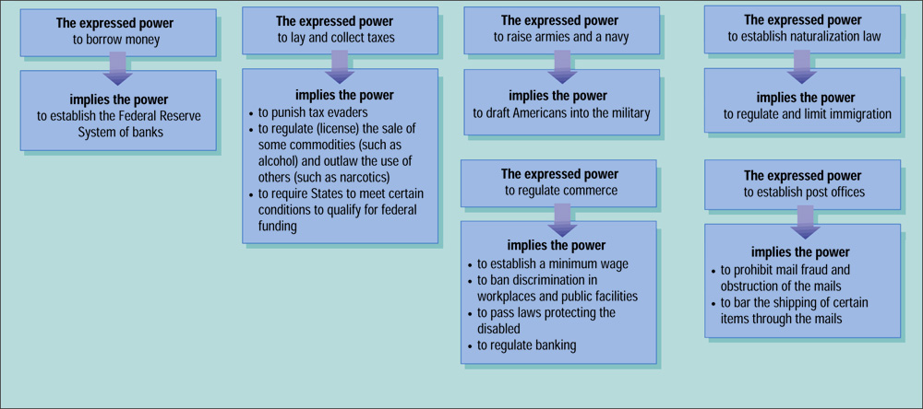
Implied Powers

Slide 9
Limits on the Taxing Power
A tax is a charge levied by government on persons or property to meet public needs.
The Constitution places four limits on Congress’s power to tax:

Slide 10
Investigatory Power

Slide 11
Executive and Impeachment Powers
Appointments
All major appointments made by the President must be confirmed by the Senate by majority vote.
Treaties
The President makes treaties “by and with the Advice and Consent of the Senate,... provided two thirds of the Senators present concur.”
The House has the sole power to impeach, or bring charges against the individual.
There is then a trial in the Senate. A two-thirds vote of the senators present is needed for conviction.
The penalty for conviction is removal from office.

