Slide 1
Bell ringer
Write three facts from this video. They must pertain to how a bill becomes a law.

Slide 2
Lesson 3.5
Refer to Chapter 12
How A Bill becomes a law

Slide 3
Objectives (Do Not Copy)
List the types of Bills and resolutions.
List the steps in a bill becoming a law.

Slide 4
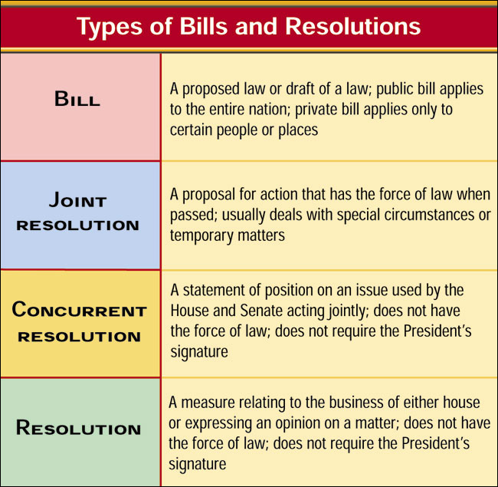
Types of Bills and Resolutions
A bill is a proposed law presented to the House or Senate for consideration.

Slide 5
What comes first?
A member of the House or Senate drafts a bill.
They submit the bill to the House or Senate.
The bill is assigned a number that begins with:
H.R. for House of Representatives
S. for Senate
The bill is then sent to the appropriate committee.

Slide 6
The Standing Committee
1.This is a permanent committee in the House or Senate that studies bills related to a general topic, such as education, agriculture or science.
2. The committee discusses the bill.
3. Committee members suggest and vote on amendments.
4. The committee votes on whether to send the bill to the full House or Senate.
5. The committee chair assigns the bill to the appropriate subcommittee.
6. If the bill passes, the committee writes a report explaining:
The key points of the bill
The changes they have made
How this bill compares to current laws
Why they recommend this bill for approval
7. The bill and the report are then sent to the full House or Senate.

Slide 7
The Subcommittee
The subcommittee studies bills related to a sub-set of the topics covered by the standing committee.
All of the members of the subcommittee are part of the standing committee.
Most of the discussion in Congress takes place here.
The chair of the subcommittee, in consultation with other committee members, decides whether to schedule a bill for discussion.
The subcommittee may also decide to stop action on a bill that they think is not necessary or wise. The bill then dies.
The subcommittee first holds hearings on the bill, giving supporters, opponents and experts a chance to voice their views.
Amendments (changes) to the bill are then suggested and voted on.
The subcommittee may also decide to write an entirely new bill.
Finally, the subcommittee votes on whether to take the bill to the full committee for a vote.
If the bill does not pass, it dies.

Slide 8
The Conference Committee
The conference committee includes members of both the House and the Senate.
The committee discusses the differences between the two bills.
They re-write the bill in a form that they think will pass in both the House and the Senate and vote on it.
After they pass the re-written bill, the committee writes a report that contains:
The re-written bill
An explanation of how they worked out the differences between the two bills

Slide 9
Back to the Floor
The conference committee report with the re-written bill is sent to the House for a vote.
If the House passes the bill, it is sent to the Senate.
If the House or the Senate does not pass the bill, it dies.
If the bill passes in both the House and the Senate, it is sent to the President.

Slide 10
Debate on the Senate Floor
The bill is placed on the calendar of the House or Senate until it is scheduled for discussion.
The House and Senate have different rules for debating the bill.
The Senate is chaired by the Vice President; the President Pro Tempore may chair in his place.
There are no time limits to debate in the Senate. Members may speak for as long as they choose.
Amendments may be offered at any time during debate.
A Filibuster may occur, which is talking a bill to death.

Slide 11
Debate on the House Floor
The House is chaired by the Speaker of the House
Before debate begins, a time limit is set for how long any Member can speak (usually 1 – 5 minutes).
First a Member speaks who is for the bill and then one who is against the bill. Debate continues in this way.
Debate on a bill can be ended by a simple majority vote.
Following this debate, amendments to the bill can then be suggested and debated. The same rules apply.
Finally, the bill is put to a vote.

Slide 12
Executive Action
The President has 4 options:
Sign into law. He can sign the bill, which then becomes a law.
Law without signature. He can let the bill sit on his desk for 10 days without signing it while Congress is in session. The bill then becomes a law.
Veto. He can choose to not sign the bill, so it will not become a law. However, if the bill is then passed by 2/3 of both the House and the Senate, it still becomes a law.
Pocket veto. If, after 10 days, he has not signed it and Congress is no longer in session, the bill does not become a law.

