Slide 1
Ancient America

Slide 2
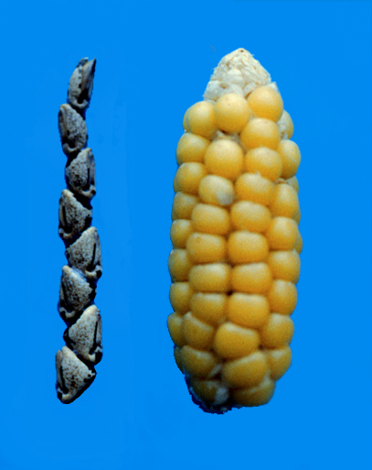
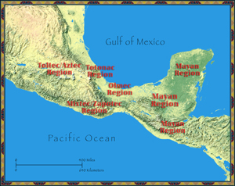
Mesoamerica
“Middle America”
Domesticate animals and plants (8500BC-2000BC)
Maize, potatoes, tomatoes, beans
Populations boomed→ great cities
Notes:
What do you think “Meso” means? Where? Corn about actual size, ancient maize is very small

Slide 3
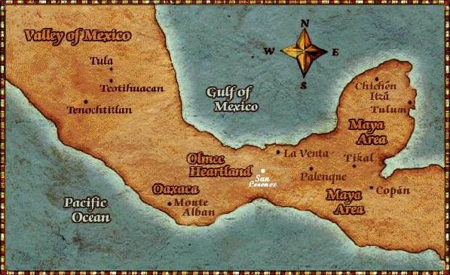
The Maya
300 BC to 900 AD→ The Classic Period
Yucatán Peninsula to Central America
Never an empire: city-states
Ex: Tikal (most powerful)
Each ruled by chief

Slide 4
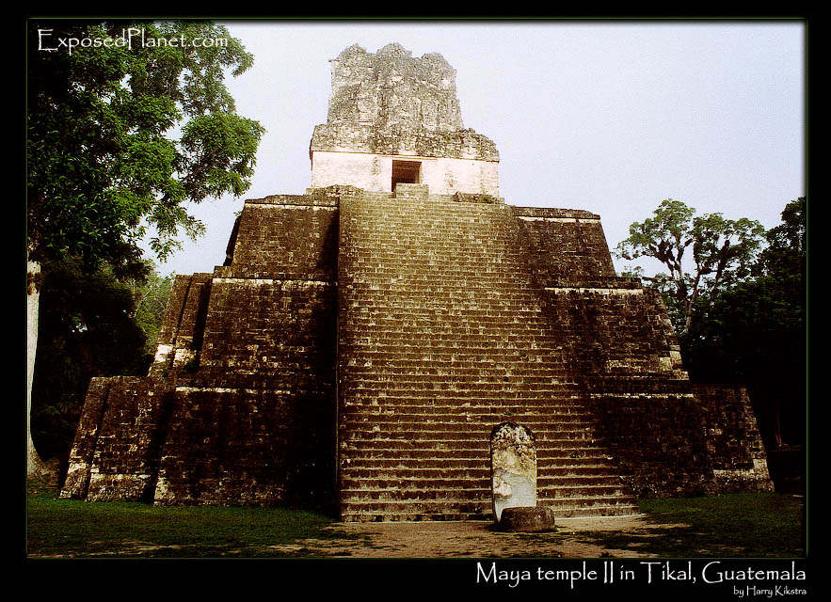
Society & Farming
Most are farmers
Slash and burn to forests
Raised fields on rivers
Maize, beans, cotton, tropical flowers
Food taxes
Polytheistic
Central to life
Priests very powerful
Elaborate ceremonies

Slide 5
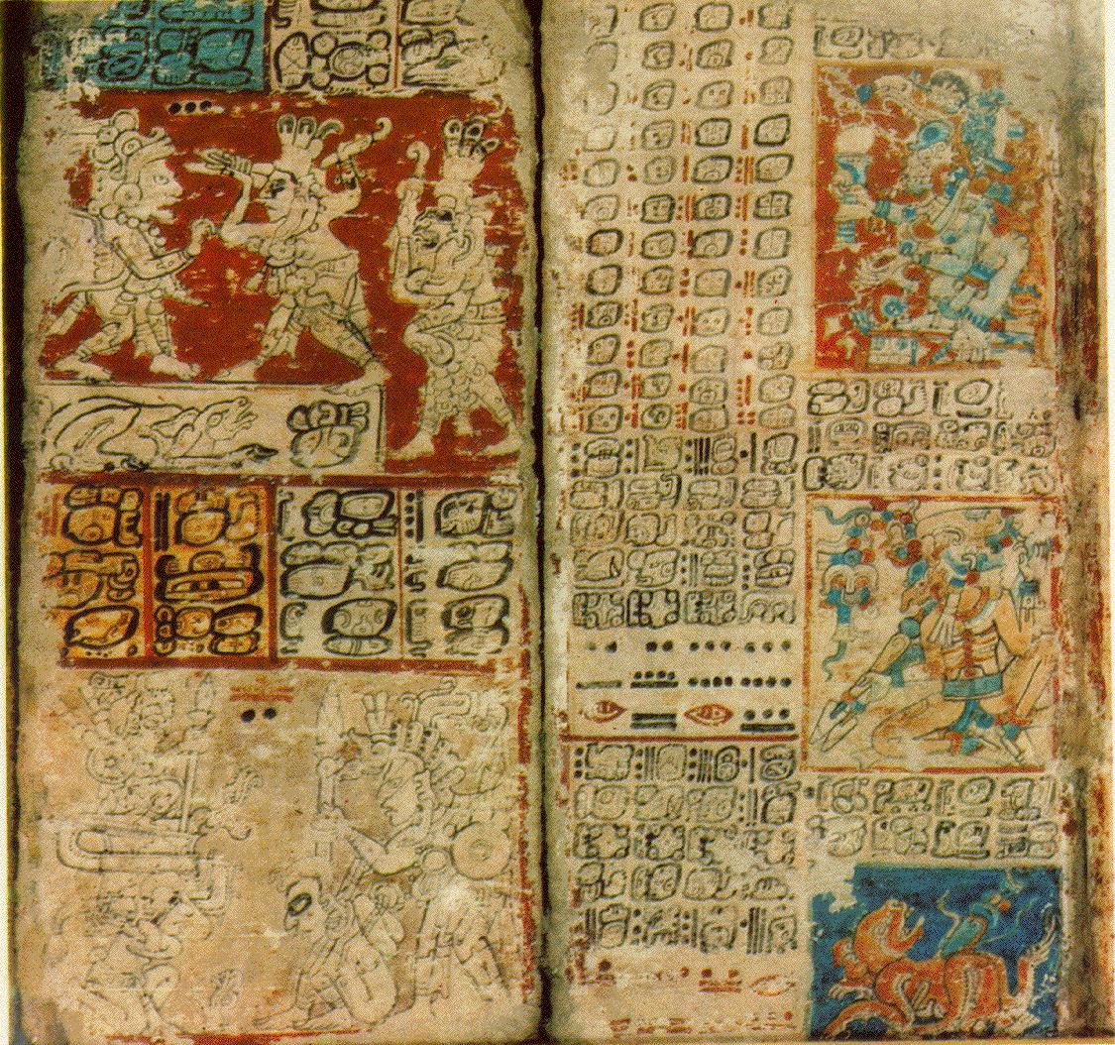
Achievements
Hieroglyphics
Create codexes
Many burned by Spanish
Astronomy
Very accurate
365 day solar calendar
Complex numbering system & value of zero

Slide 6
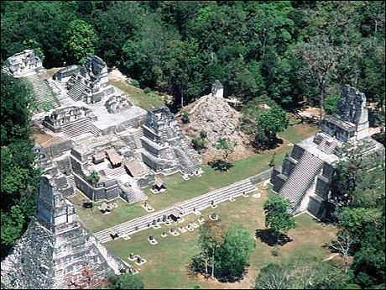
Decline
Abandon cities—why?
Theories:
War
Overpopulation
Peasant revolt

Slide 7
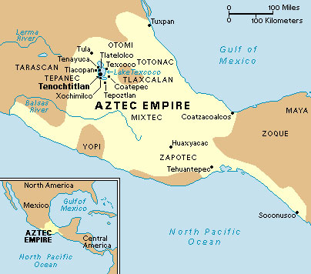
Aztecs
1200s-1500s
Called selves Mexica
In modern day Mexico
Why?
Wandered for 200 yrs looking for a sign
An eagle with a serpent trapped in its mouth, atop a prickly cactus growing on a rock submerged in a lake.
Finally found this off an island in Lake Texcoco
Built their capital city, Tenochtitlán, large population

Slide 8
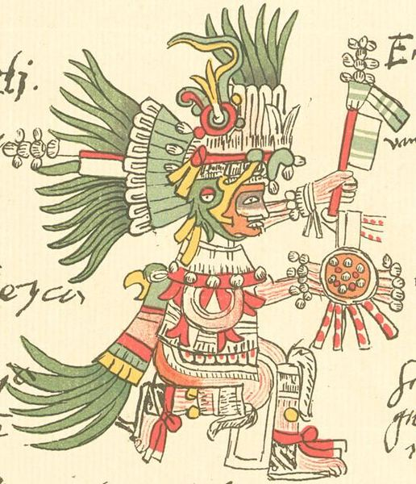
Government & Religion
Single empire
Emperor meant to lead in war
Called “The Great Speaker”
Polytheistic
Huitzilopochtli – supreme god
Quetzecotal – feathered-serpent god (god of earth and water)
Priests very powerful
Human sacrifices
Beleived the gods sacrificed themselves, so should man

Slide 9
Farming
Science
Chinampas
“floating garden”
Artificial islands
Believed illness caused by the gods
Herbs and meds
Set broken bones/fill cavities
Steam baths
Accurate calendar
Hieroglyphics
Decline
Spanish invaders in 1500s (Conquistadors)
Hernado Cortes

Slide 10
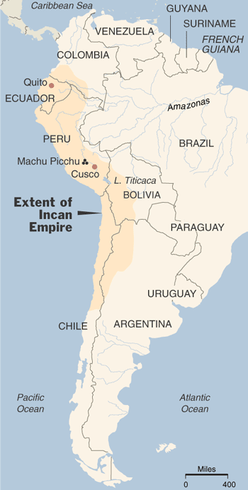
The Inca
1100s-1500s
Ecuador to Chile
Andes Mountains
Hard to farm
Capitol City: Cuzco
Machu Picchu

Slide 11
Government
Empire
God-King called “Sapa Inca”
Owned all lands, herds, mines, & people
Coya—queen, in charge of religious duties
Efficient government with trained officials
Religion & Farming
Polytheistic—linked to nature
Monthly rituals/offerings
Priests powerful
Farming
Step terraces
Potatoes and maize

Slide 12
Achievements
Unified empire with road networks
14,000 miles through mts & deserts
Llamas
Skilled metalwork & weavers
Wool from llamas
Copper, tin, bronze
Surgery on skull, antiseptics, & mummification
Decline
Pizarro invades and overthrows emperor

